Slide 1
Project 1: Language Design
Olivia bravo

Slide 2
Language Design
Many programming languages are similar
Contains:
Variables – A value that can be changed
Syntax – Set of rules
Input – Information supplied to a computer or program
Output – Data generated by a computer
This PowerPoint will demonstrate the similarities between C++ and Python in a simple multiplication program

Slide 3
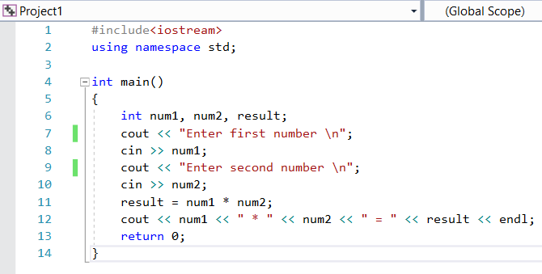
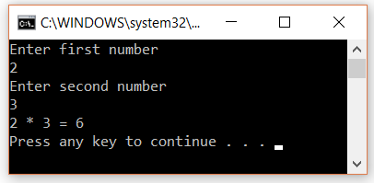
C++ Program
In C++, for a program to run it needs the headers in line 1 and 2 to enable input and output (cin and cout respectively)
The code is run through the main program defined by int main()
The code is contained in the main program using the curly brackets { and }
Variables num1, num2, and result are initialized as an int (integer) data type
The statement return 0 tells the program to end there successfully
Output:

Slide 4
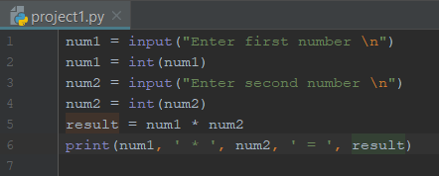
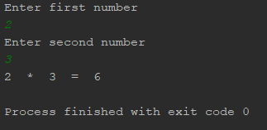
Python Program
In python, variables don’t have to be declared a data type unlike C++
A main function is not needed in this specific python program
When inputted, num1 and num2 default to a string datatype
The function int() converts the string to an int data type
To output, python uses print
Output:

Slide 5
Similarities of C++ and Python
Both contain variables. Example: num1, num2, result
Both can take an input from the user
In C++: cin >>
In Python: input()
Both can output
The output of both is the exact same even when C++ and Python are different languages

